Slide 1
Types of Movement

Slide 2
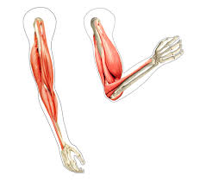
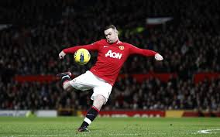
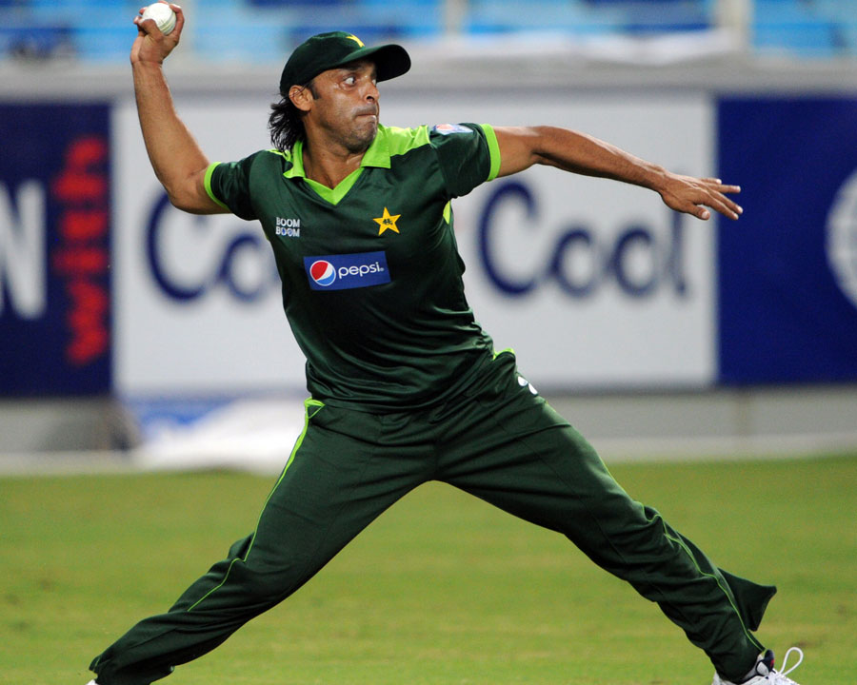
Flexion
Flexion is reducing the angle of the joint. Muscles contract, moving the joint into a bent position. Examples include bending your arm in a bicep curl or bending your knee back ready to kick a ball.
What would flexion at the hip, shoulder and wrist look like?

Slide 3
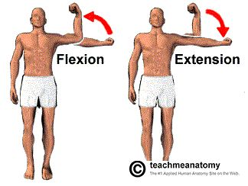
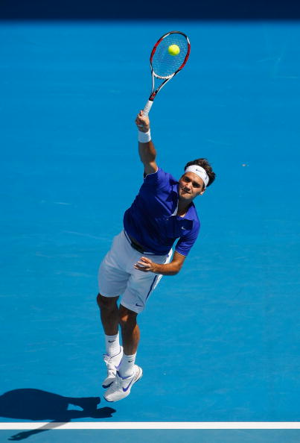
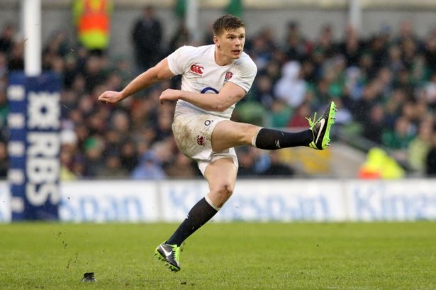
Extension
Extension, being the opposite to flexion, is the straightening of the limb to increase the angle at the joint. An example could be straightening the arm as you serve in tennis or straightening the leg as you kick a ball.

Slide 4
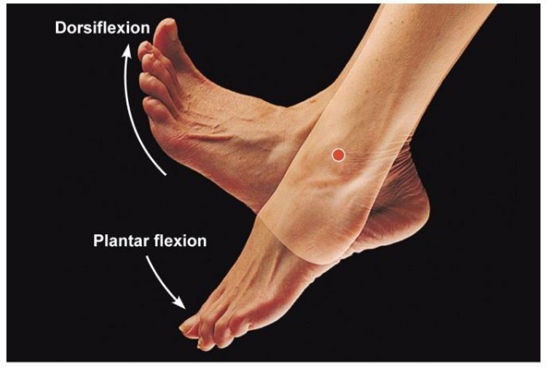
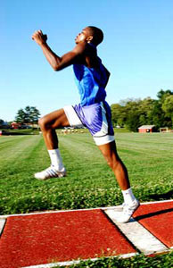
Dorsiflexion/Plantar Flexion
Dorsiflexion is raising the toes up towards the leg. An example would be raising the angle of the foot in the lead leg when sprinting.
Plantar flexion is pointing your toes downwards. This is common in gymnastic but also happens when pushing off the ground when running or jumping.

Slide 5
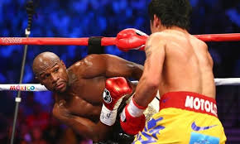
Lateral/Horizontal Flexion
The movement of bending sideways, for example at the waist to dodge a punch in boxing.
Horizontal flexion is bending the elbow while the arm is in front of the body, straightening the arm is horizontal extension.

Slide 6
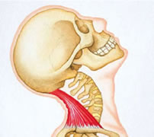
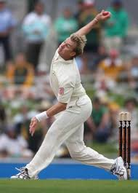
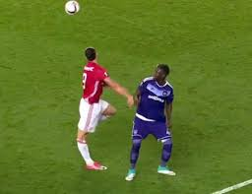
Hyper Extension
Involves movement beyond the normal anatomical position in direct opposite to flexion.
An example is when a cricket bowler arches their back before bowling.

Slide 7
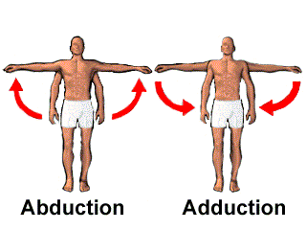
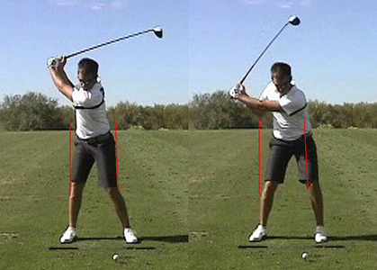
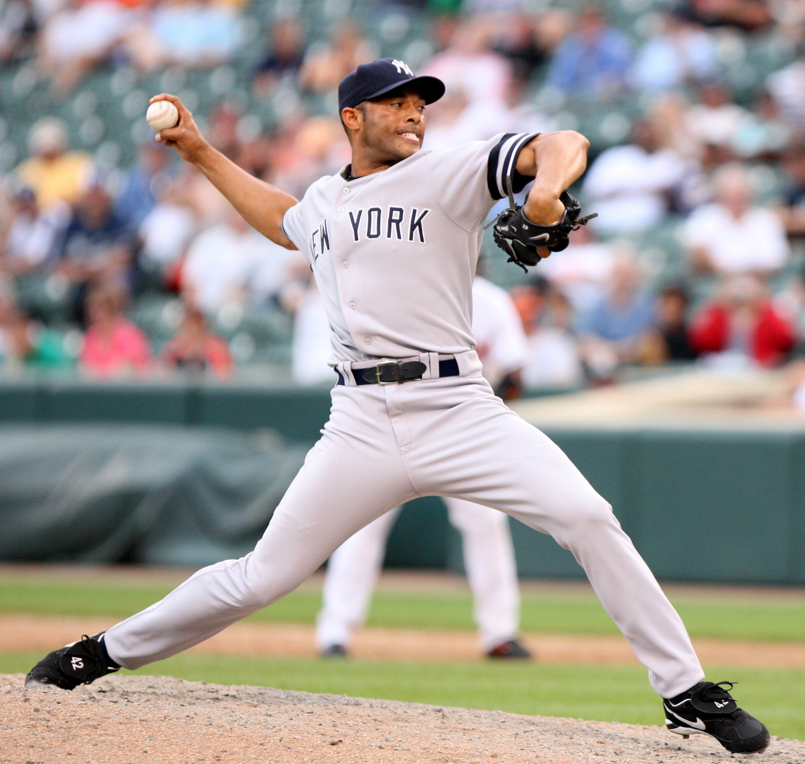
Abduction/Adduction
Abduction is when you take a limb away from the midline of the body
Adduction is when you bring the limb towards the midline
Horizontal abduction is bringing the arm across your body.
Horizontal flexion is moving the arm across and away from the body.

Slide 8
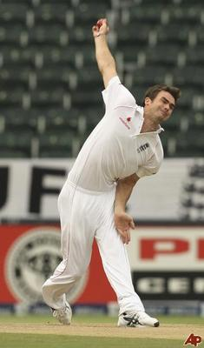
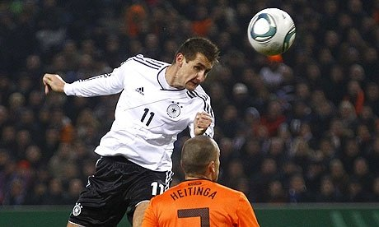
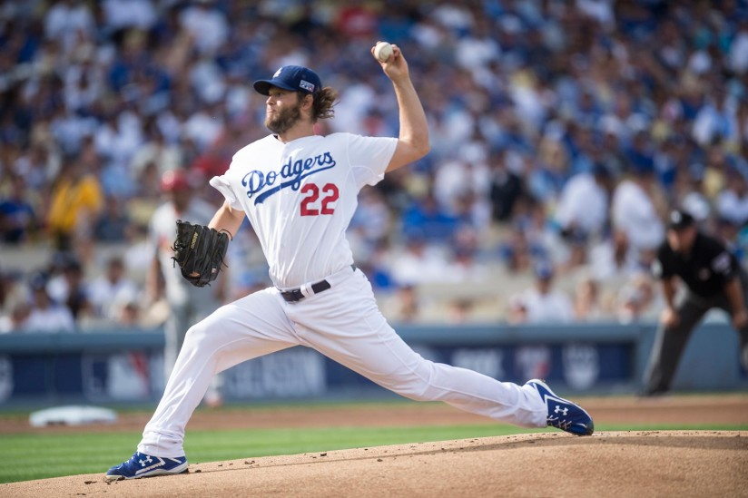
Rotation/Circumduction
Circumduction is moving a limb in a circular motion, for example bowling in cricket.
Rotation is a partial circular movement, for example rotating at the neck to head the ball or rotating the shoulder back to throw a ball.

Slide 9
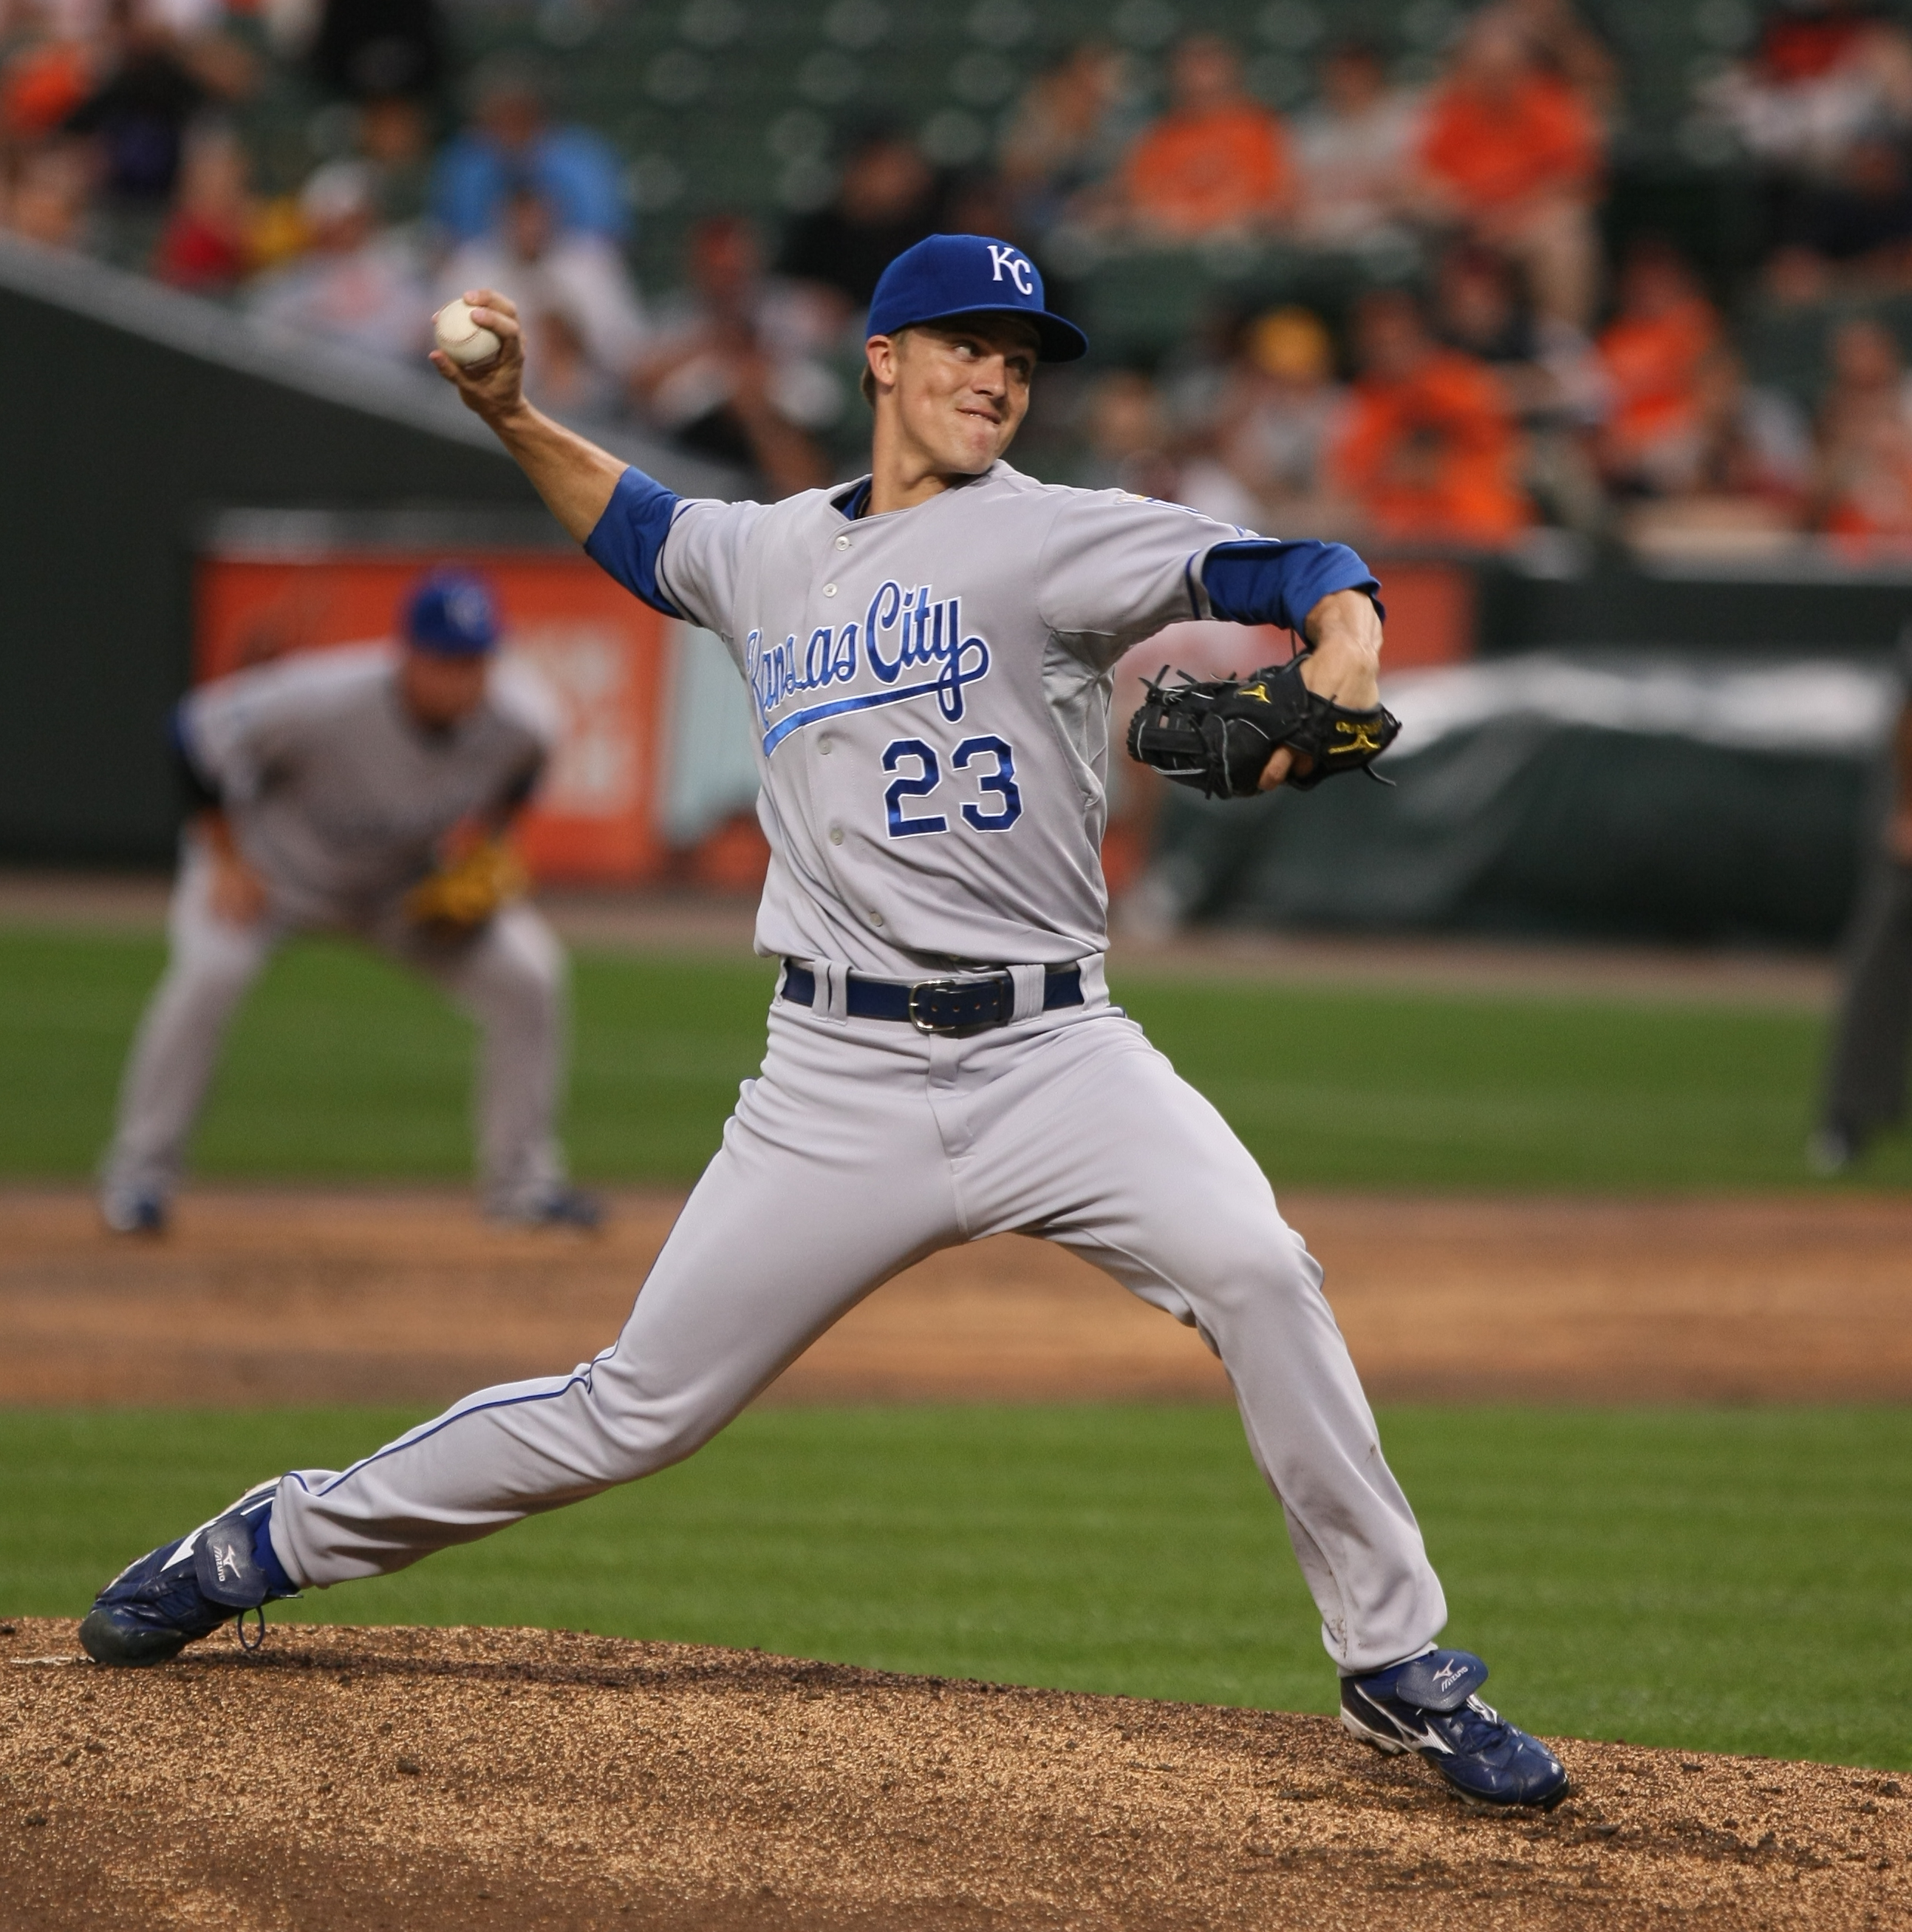
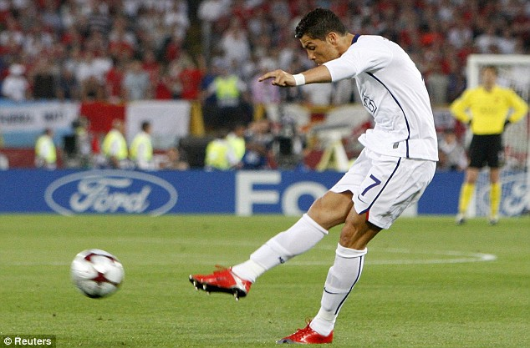
Movement Analysis

Slide 10
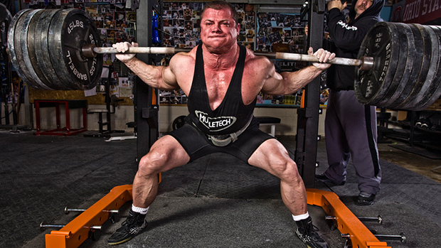
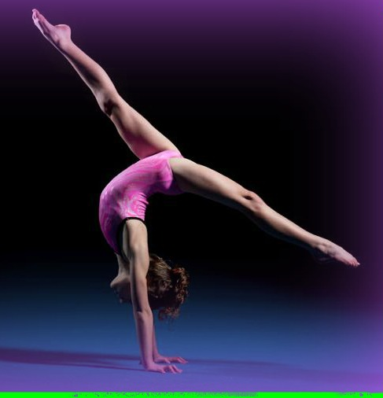
Movement Analysis

